Slide 1

Web based system using chatGPT
By Akanksha Singh, 19745

Slide 2
INTRODUCTION
WE WILL BUILD A WEB BASED SYSTEM USING CHATGPT
FIRST STEP IS TO BUILD AN AI THAT CAN ANSWER OUR QUESTION WITH THE HELP OF OPENAI API KEY.
SECOND STEP IS TO BUILD A UI WHERE WE CAN ENTER OUR PROMT AND GET A RESPONSE.
THIRD STEP IS TO INTEGRATE THE FIRST TWO STEPS.

Slide 3
TABLE OF CONTENTS
1. Steps followed to build an AI
Set up an OPENAI API KEY
Set up a Web Crawler
Build an Embedding Index
Build a Q/A with Embedding
2. Used flask to build a webserver for Q/A
Run the crawler on the terminal in the cloned repository
Create index.html
Run the app
4. Conclusion
5. References
6. Github link
3. Video demo

Slide 4
Steps followed TO BUILD AN AI
1. Set up an OPENAI API key
2. Set up web crawler
3. Building an embedding index
4. Building a Q/A system with your embeddings

Slide 5
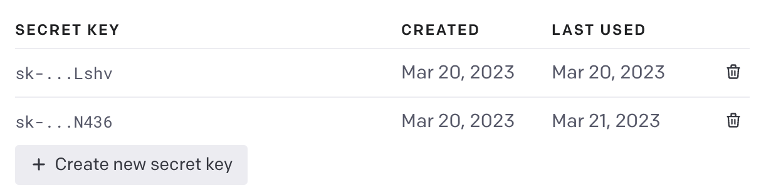
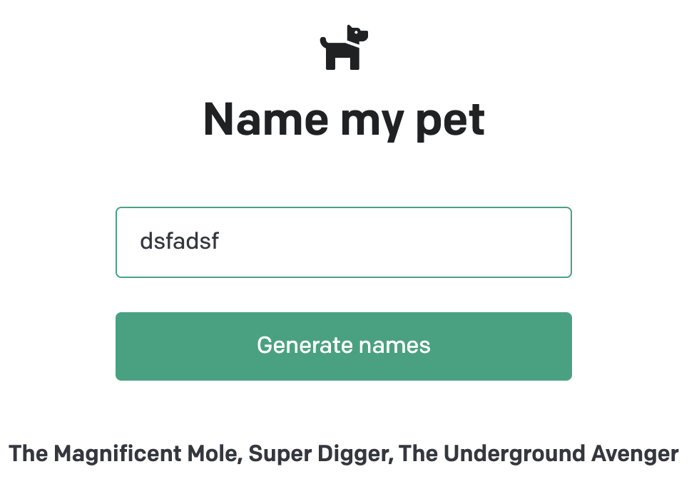
SET UP AN OPENAI API KEY
1. Create a new secret key
2. download the code by cloning this repository.
3. Copy your secret API key and set it as the OPENAI_API_KEY in your newly created .env file
4. Run the app depending on your setup
5. Open http://localhost:5000 in your browser and you should see the pet-name generator.

Slide 6
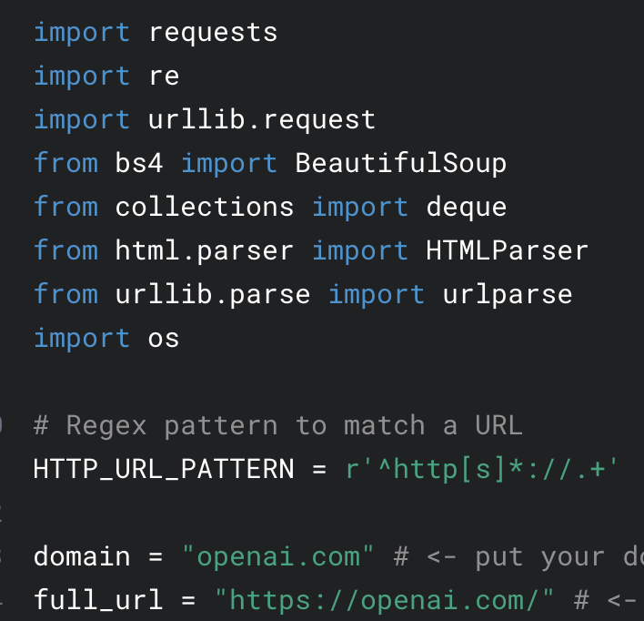
Setup a web crawler
Import the required packages
Set up the basic URL
Define a HTML Parser class
The crawler will start from the root URL passed in the code. We are using BFS algorithm here.
Visit each page recursively.
Find additional links and visit those pages as well (until they have the same root domain).

Slide 7
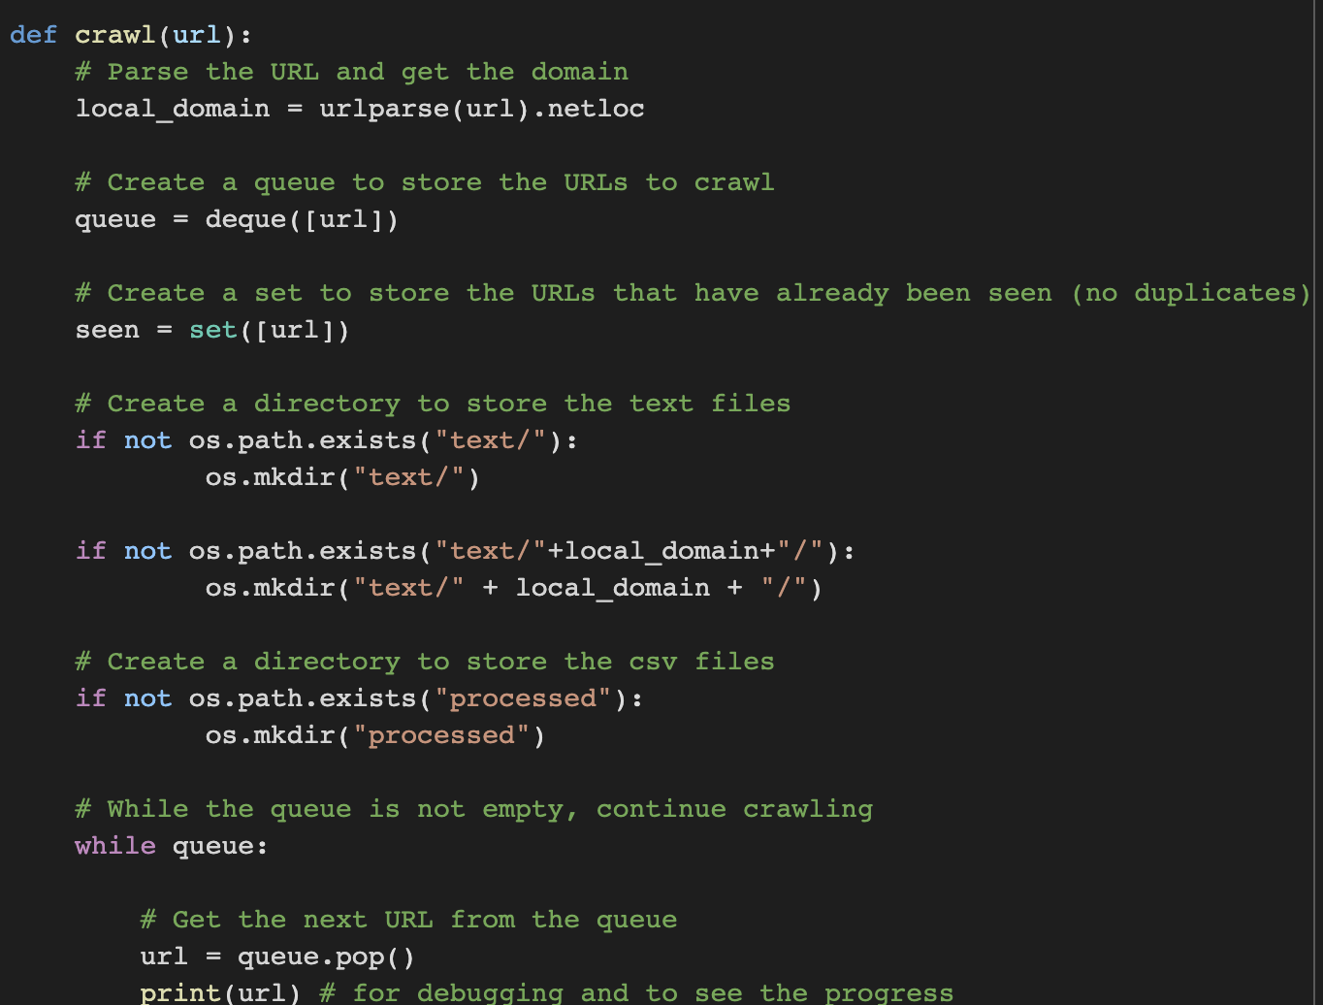
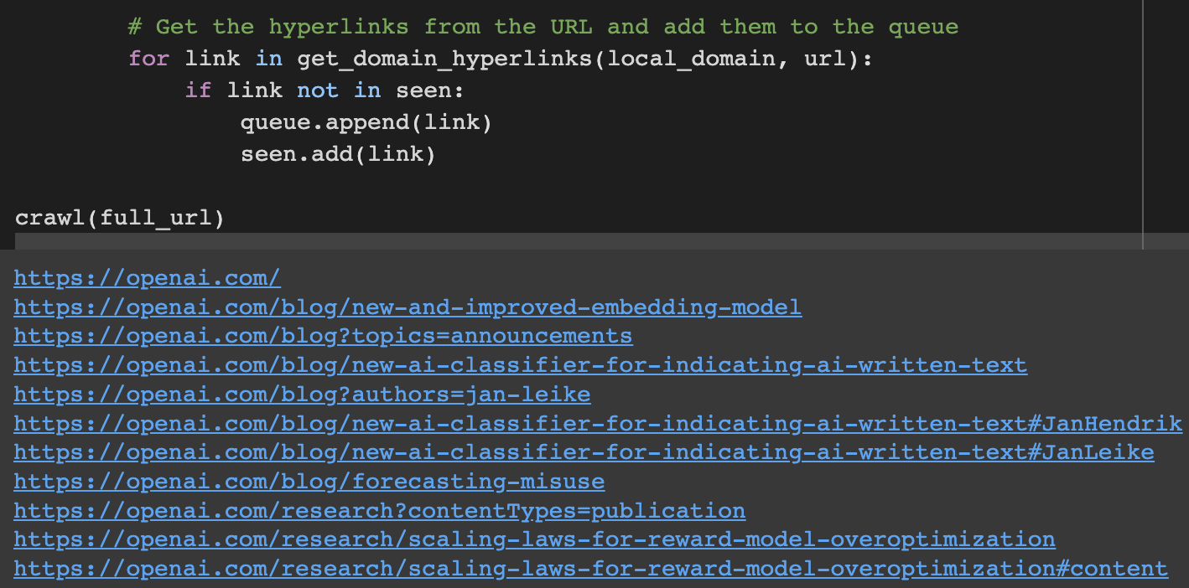
Setup a web crawler
The goal is to crawl through and index only the content that lives under the OPENAI domain
The last command runs the crawler which goes through all the accessible links and turns those pages into text files

Slide 8
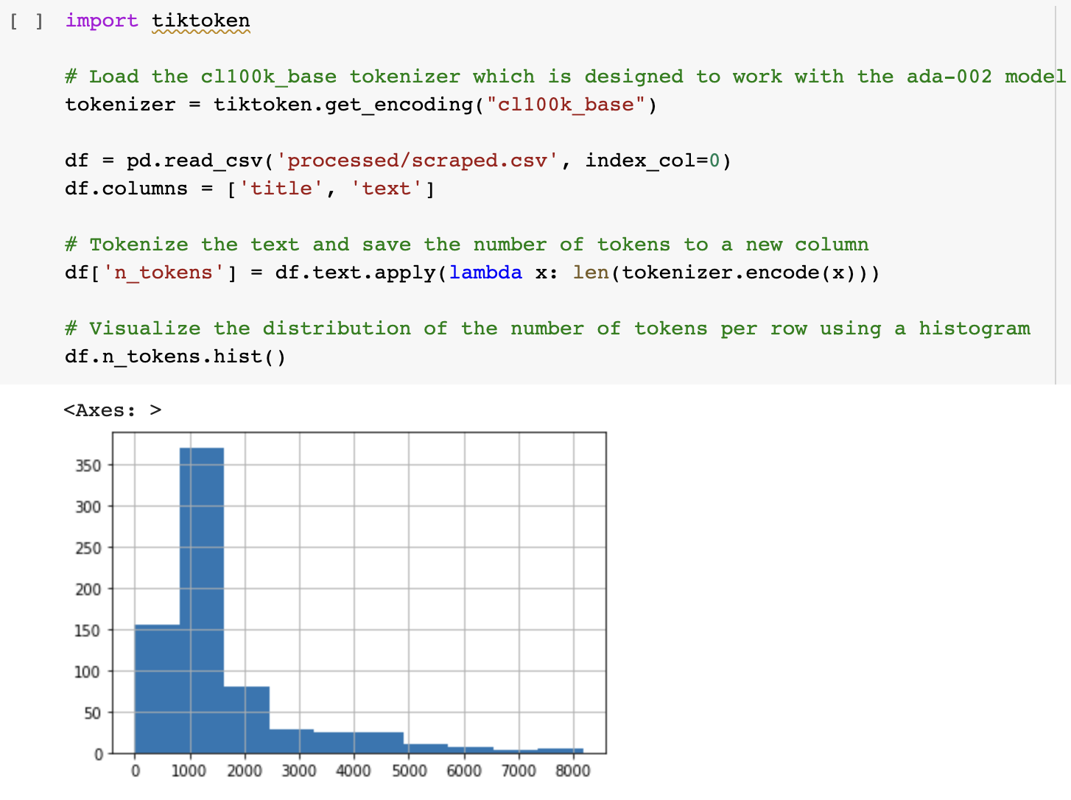
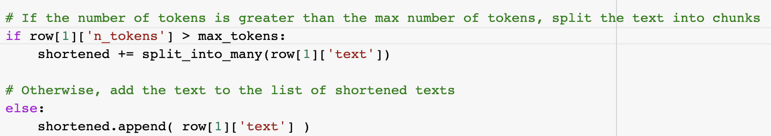
BUILDING AN EMBEDDING INDEX
Add the text with the new lines removed to an empty Pandas data frame and write the data frame to a CSV file.
Tokenization is the next step after saving the raw text into a CSV file.
It splits the input text into tokens by breaking down the sentences and words.
There is a limit of max tokens which is 500 so it breaks the text into small chunks.

Slide 9
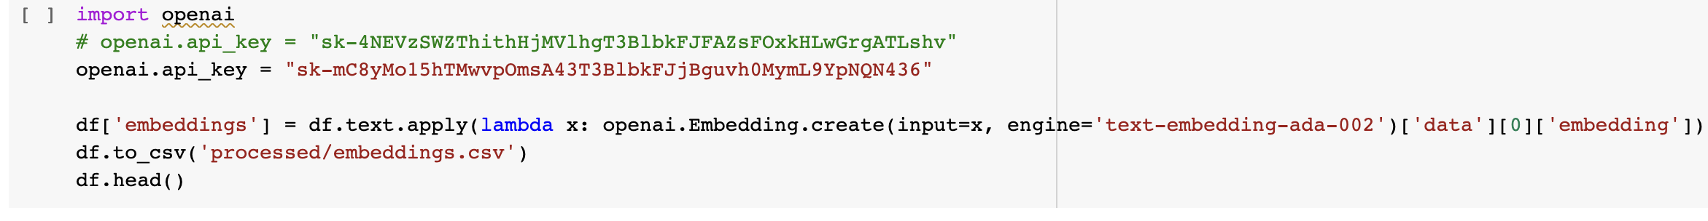
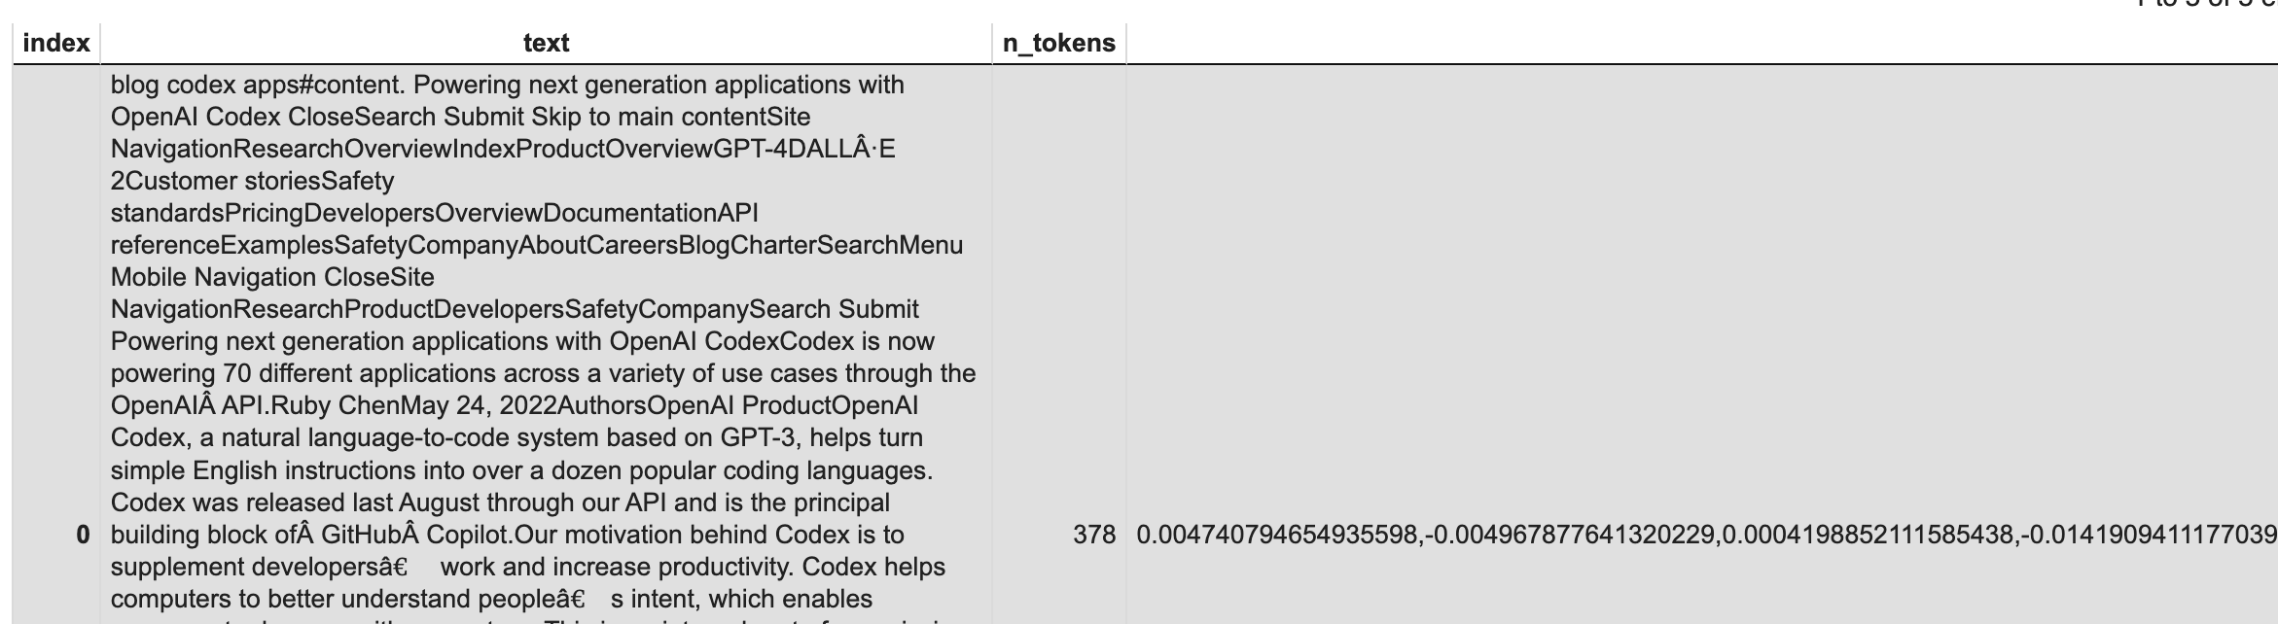
Building an embedding index
Every subpage is scraped so the next code chunk will split the longer lines into smaller chunks.
The content is now broken down into smaller chunks and a simple request can be sent to the OPENAI API specifying the use of the new text-embedding-ada-002 model to create the embeddings

Slide 10
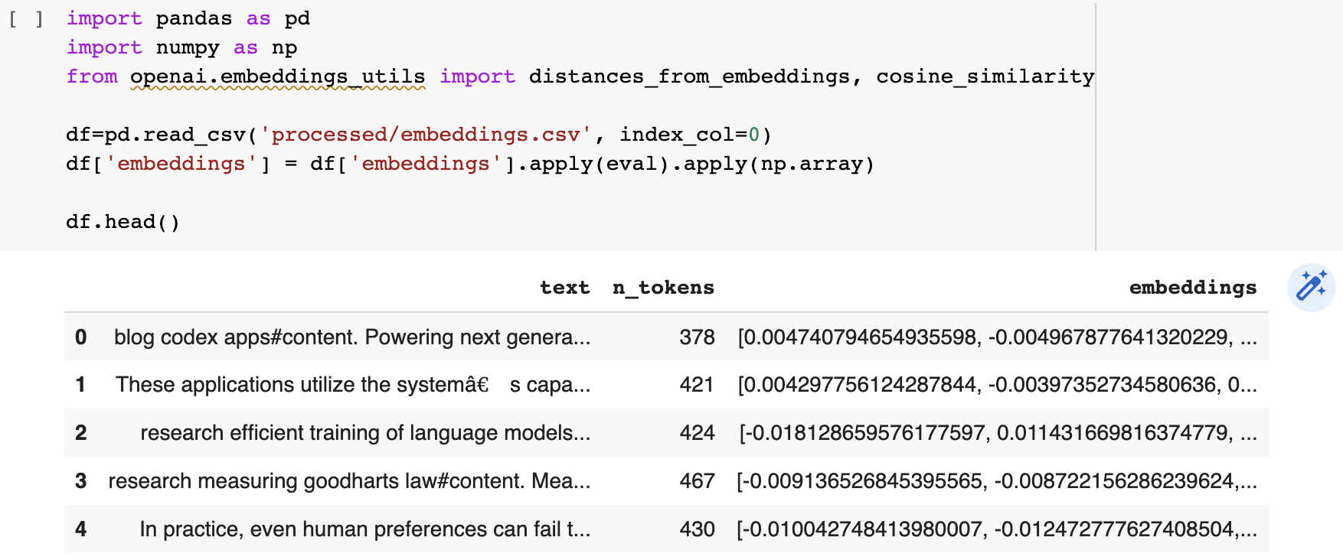
Building a q/a with embedding
Turning the embeddings into a NumPy array is the first step
The question needs to be converted to an embedding with a simple function
The text was broken up into smaller sets of tokens, so looping through in ascending order and continuing to add the text is a critical step to ensure a full answer
If there is no relevant answer, the prompt will return “I don’t know”.

Slide 11
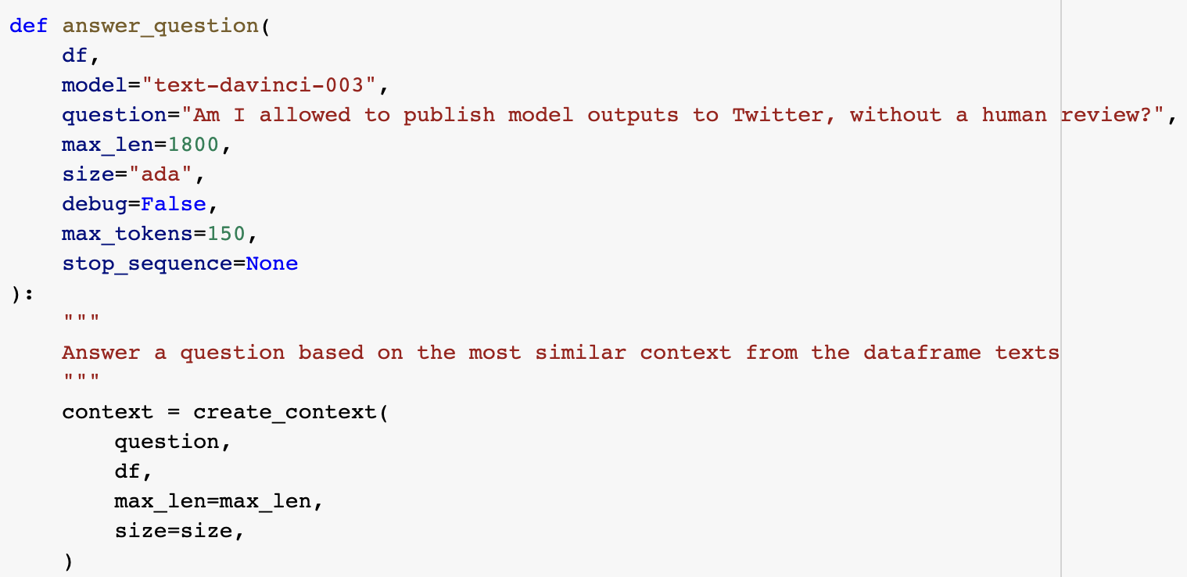
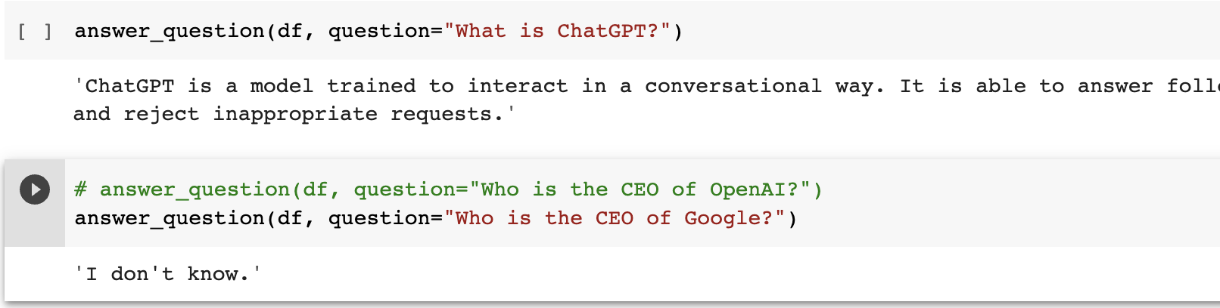
Building a q/a with embedding
The embeddings are ready. The final step of this process is to create a simple question and answer system. This will take a user's question, create an embedding of it, and compare it with the existing embeddings to retrieve the most relevant text from the scraped website. The text-davinci-003 model will then generate a natural sounding answer based on the retrieved text.

Slide 12
USING FLASK TO MAKE A WEBSERVER FOR Q/A
Run the crawler on the terminal in the cloned repository
Create an index.html file as per your user interface.
Set up all the dependencies and run the application using flask.
Visit the url: http://127.0.0.1:5000/
And now you can query the web-based server about your website.

Slide 13

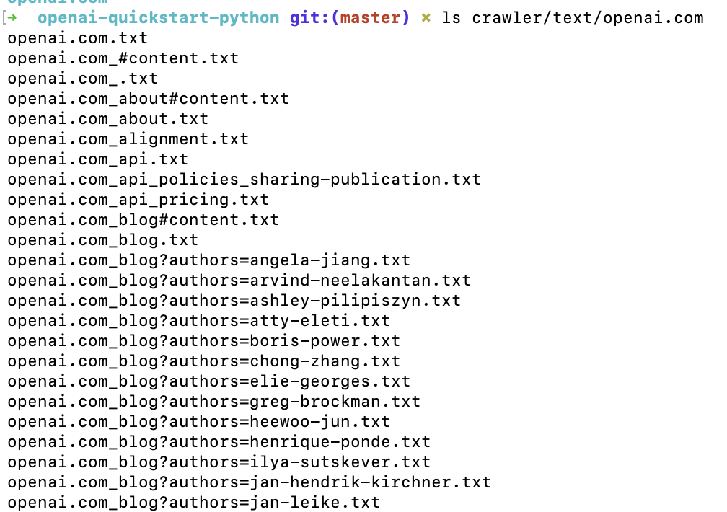
Run the crawler on the terminal in the cloned repository

Slide 14
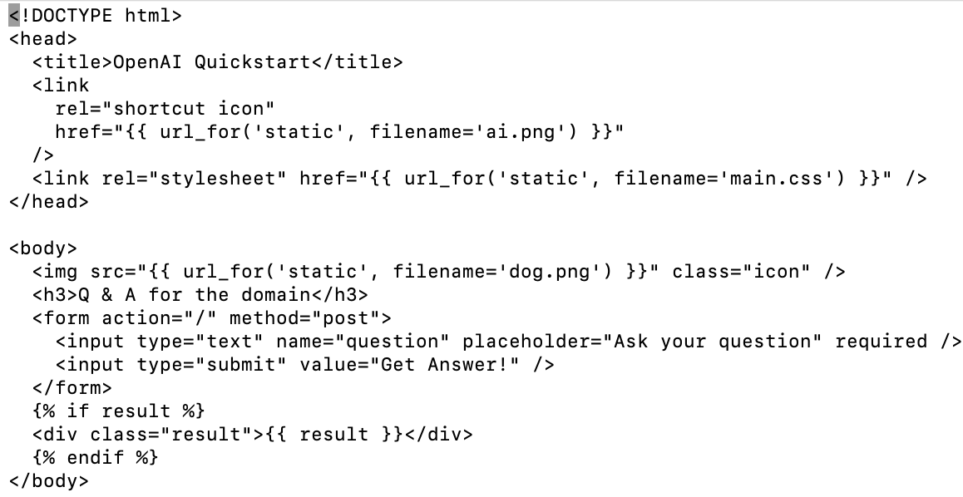

Create an index.html file as per your user interface.

Slide 15

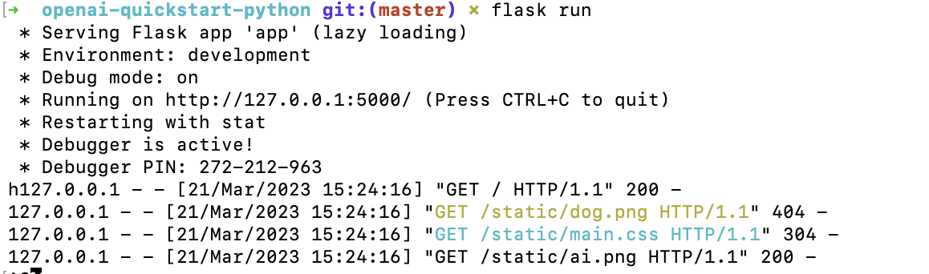
Set up all the dependencies and run the application using flask.

Slide 16
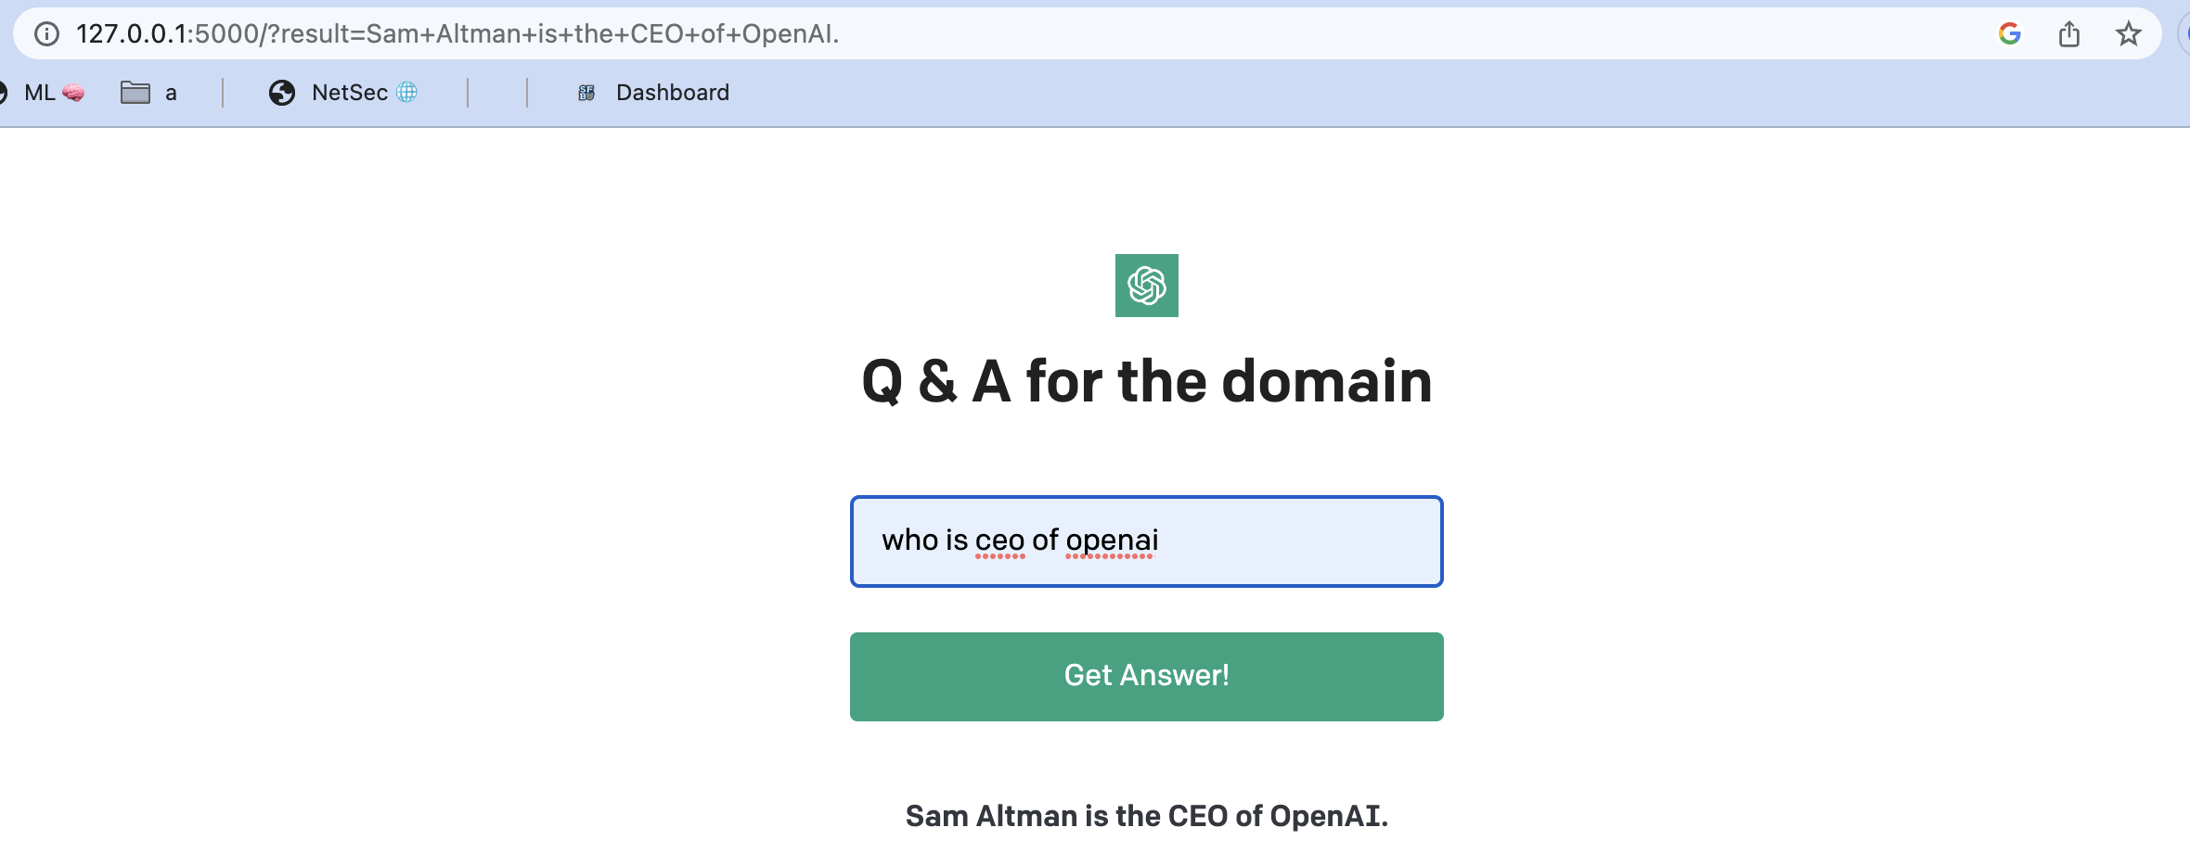
Visit the url and query the webserver

Slide 17
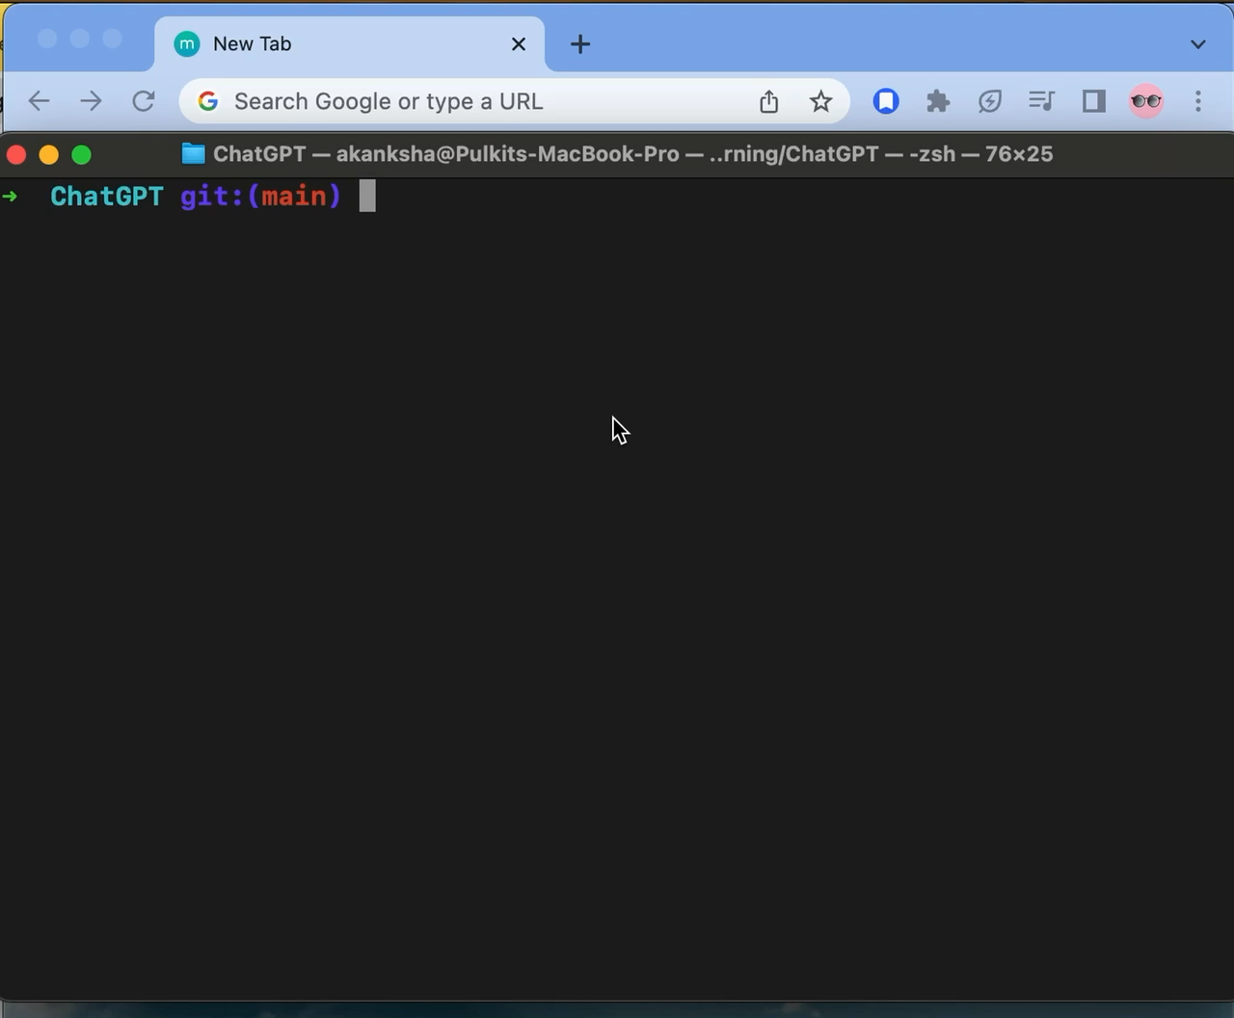
Video demo

Slide 18

conclusion
We need to make embeddings of the question and the webpage url texts and then find out the most relevant answer to the question. This approach is good for prototyping.

Slide 19
Refrences
https://platform.openai.com/docs/tutorials/web-qa-embeddings

Slide 20

GITHUB LINK
https://github.com/codeyogg/Machine_learning/tree/main/ChatGPT

